Slide 1
KS2 Grammar, Punctuation and Spelling Workshop

Slide 2
Aims of this session:
To understand the KS2 GPS curriculum objectives
To understand GPS terminology
To understand a variety of methods we use to teach GPS

Slide 3
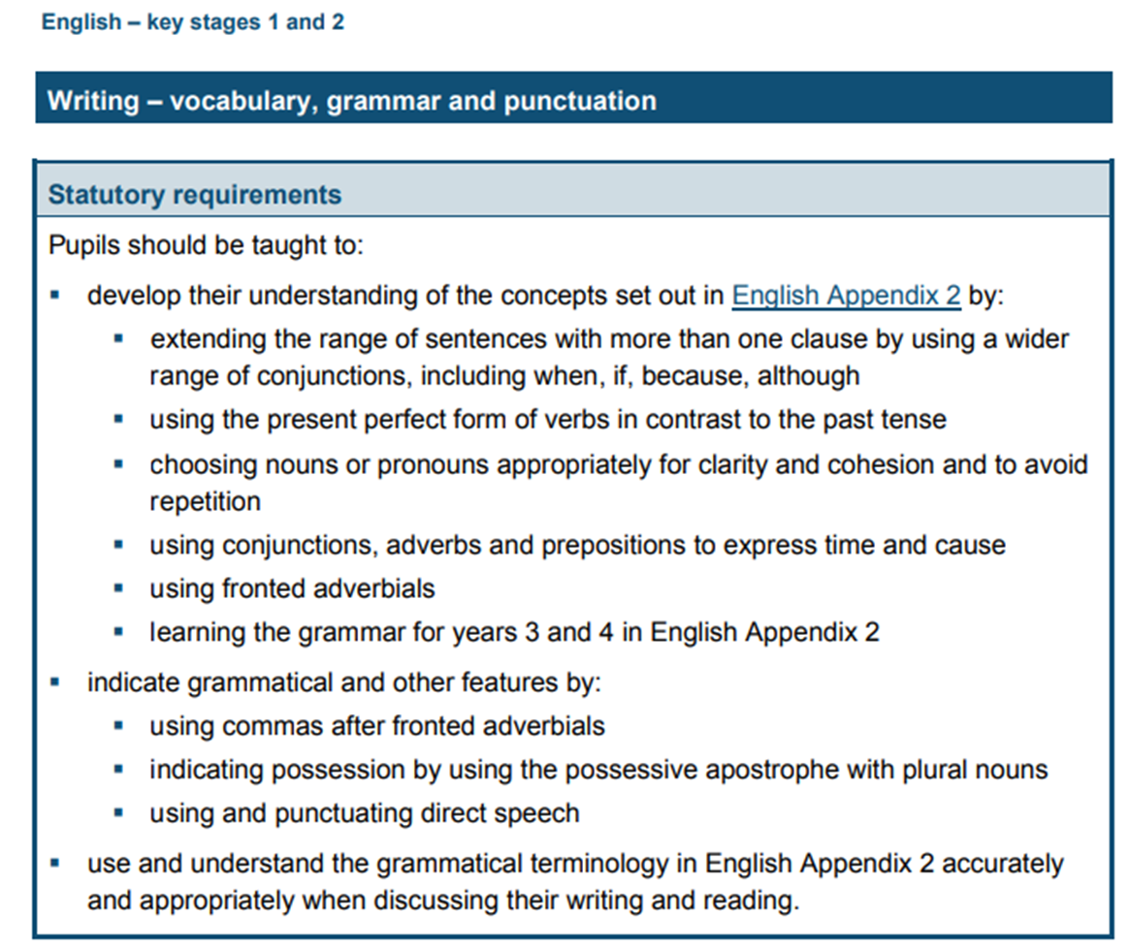
Year 3 & 4

Slide 4
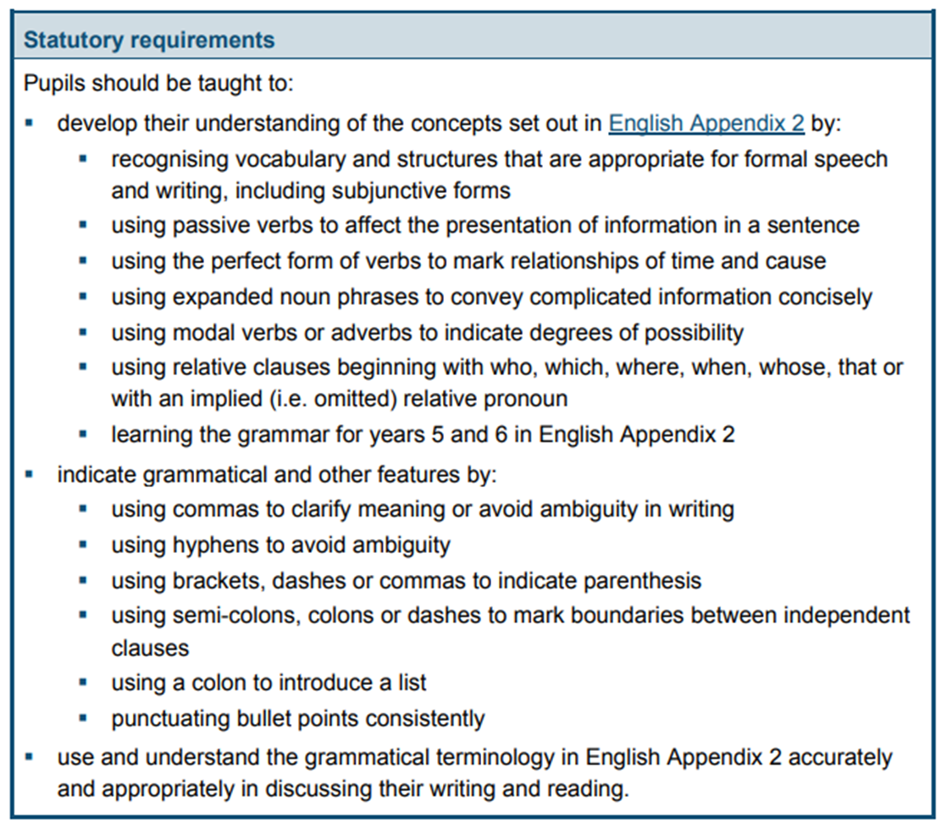
Year 5 & 6

Slide 5
Year 3
Year 3: Detail of content to be introduced (statutory requirement)
Word | Formation of nouns using a range of prefixes [for example super–, anti–, auto–] Use of the forms a or an according to whether the next word begins with a consonant or a vowel [for example, a rock, an open box] Word families based on common words, showing how words are related in form and meaning [for example, solve, solution, solver, dissolve, insoluble]
Sentence | Expressing time, place and cause using conjunctions [for example, when, before, after, while, so, because], adverbs [for example, then, next, soon, therefore], or prepositions [for example, before, after, during, in, because of]
Text | Introduction to paragraphs as a way to group related material Headings and sub-headings to aid presentation Use of the present perfect form of verbs instead of the simple past [for example, He has gone out to play contrasted with He went out to play]
Punctuation | Introduction to inverted commas to punctuate direct speech
Terminology for Pupils | preposition, conjunction word family, prefix clause, subordinate clause direct speech consonant, consonant letter vowel, vowel letter inverted commas (or ‘speech marks’)

Slide 6
Year 4
Year 4: Detail of content to be introduced (statutory requirement)
Word | The grammatical difference between plural and possessive –s Standard English forms for verb inflections instead of local spoken forms [for example, we were instead of we was, or I did instead of I done]
Sentence | Noun phrases expanded by the addition of modifying adjectives, nouns and preposition phrases (e.g. the teacher expanded to: the strict maths teacher with curly hair) Fronted adverbials [for example, Later that day, I heard the bad news.]
Text | Use of paragraphs to organise ideas around a theme Appropriate choice of pronoun or noun within and across sentences to aid cohesion and avoid repetition
Punctuation | Use of inverted commas and other punctuation to indicate direct speech [for example, a comma after the reporting clause; end punctuation within inverted commas: The conductor shouted, “Sit down!”] Apostrophes to mark plural possession [for example, the girl’s name, the girls’ names] Use of commas after fronted adverbials
Terminology for Pupils | Determiner pronoun, possessive pronoun adverbial

Slide 7
Year 5
Year 5: Detail of content to be introduced (statutory requirement)
Word | Converting nouns or adjectives into verbs using suffixes [for example, –ate; –ise; –ify] Verb prefixes [for example, dis–, de–, mis–, over– and re–]
Sentence | Relative clauses beginning with who, which, where, when, whose, that, or an omitted relative pronoun Indicating degrees of possibility using adverbs [for example, perhaps, surely] or modal verbs [for example, might, should, will, must]
Text | Devices to build cohesion within a paragraph [for example, then, after that, this, firstly] Linking ideas across paragraphs using adverbials of time [for example, later], place [for example, nearby] and number [for example, secondly] or tense choices [for example, he had seen her before]
Punctuation | Brackets, dashes or commas to indicate parenthesis Use of commas to clarify meaning or avoid ambiguity
Terminology for Pupils | modal verb, relative pronoun relative clause parenthesis, bracket, dash cohesion, ambiguity

Slide 8
Year 6
Year 6: Detail of content to be introduced (statutory requirement)
Word | The difference between vocabulary typical of informal speech and vocabulary appropriate for formal speech and writing [for example, find out – discover; ask for – request; go in – enter] How words are related by meaning as synonyms and antonyms [for example, big, large, little].
Sentence | Use of the passive to affect the presentation of information in a sentence [for example, I broke the window in the greenhouse versus The window in the greenhouse was broken (by me)]. The difference between structures typical of informal speech and structures appropriate for formal speech and writing [for example, the use of question tags: He’s your friend, isn’t he?, or the use of subjunctive forms such as If I were or Were they to come in some very formal writing and speech]
Text | Linking ideas across paragraphs using a wider range of cohesive devices: repetition of a word or phrase, grammatical connections [for example, the use of adverbials such as on the other hand, in contrast, or as a consequence], and ellipsis Layout devices [for example, headings, sub-headings, columns, bullets, or tables, to structure text]
Punctuation | Use of the semi-colon, colon and dash to mark the boundary between independent clauses [for example, It’s raining; I’m fed up] Use of the colon to introduce a list and use of semi-colons within lists Punctuation of bullet points to list information How hyphens can be used to avoid ambiguity [for example, man eating shark versus man-eating shark, or recover versus re-cover]
Terminology for Pupils | subject, object active, passive synonym, antonym ellipsis, hyphen, colon, semi-colon, bullet points

Slide 9
Terminology
Please refer to the terminology sheet in your pack! This simplifies what the National Curriculum states about writing, which GPS feeds into.

Slide 10
Weekly GPS Timetable

Slide 11
Example: Spelling Rule Teaching Slides

Slide 12
6
1
To be able to segment words into the correct syllables and phonemes
To spell words with irregular spelling patterns
This week’s words: accommodate, available, competition, determined, existence, identity, muscle, prejudice, rhyme, suggest

Slide 13
Starter
Can you help to correct my spelling mistakes
on these Stage 5 words?
Tell your partner what mistakes I have made.
sinceer
dout
knite
decieve
changable
Notes:
These are some of the Year 5 challenge words taken from Stage 5, Lesson 32.
Discuss why these may be tricky to learn.

Slide 14
Starter
Can you help to correct my spelling mistakes
on these Stage 5 words?
Tell your partner what mistakes I have made.
sinceer
sincere
dout
doubt
knite
knight
decieve
deceive
changable
changeable
Notes:
These are some of the Year 5 challenge words taken from Stage 5, Lesson 32.
Discuss why these may be tricky to learn.

Slide 15
This Week’s Words
Do you know what they mean?
accommodate
available
suggest
muscle
competition
existence
prejudice
determined
identity
rhyme

Slide 16
Word Facts
What is a muscle?
Muscle is tissue with the body which contracts and relaxes, allowing for movement.
Names of some muscles include:
biceps = a French and Latin word in origin and meaning two-headed.
triceps = derived from a Latin word meaning three-headed.
There are over 600 muscles in the human body.
Muscles are attached to your bones by tendons.
Muscles work in pairs; while one contracts, the other relaxes.

Slide 17
Etymology
muscle
The word ‘muscle’ was first introduced to the English language in 1392 and was spelled ‘mucell’.
‘Mucell’ was borrowed from the Latin word ‘musculus’ and means ‘little mouse’. This was because some muscles resembled the shape and movement of a mouse.
👍🏻
In Greek, the word ‘mys’ means both ‘mouse’ and ‘muscle’.
In German, ‘maus’ means ‘mouse’ and ‘the ball of the thumb’.

Slide 18
Etymology
existence
Latin ‘existere’
meaning ‘stand forth, come out, emerge’.
Medieval Latin
(4th-10th
centuries)
‘existential’.
In the late 14th
Century meaning ‘reality’ from
Old French word
‘existence’.
‘ex’ meaning ‘out’
‘sistere’ meaning ‘to stand’
existere
Can you think of any other words which may have derived
from the same meaning?

Slide 19
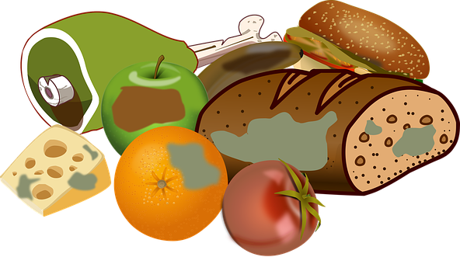
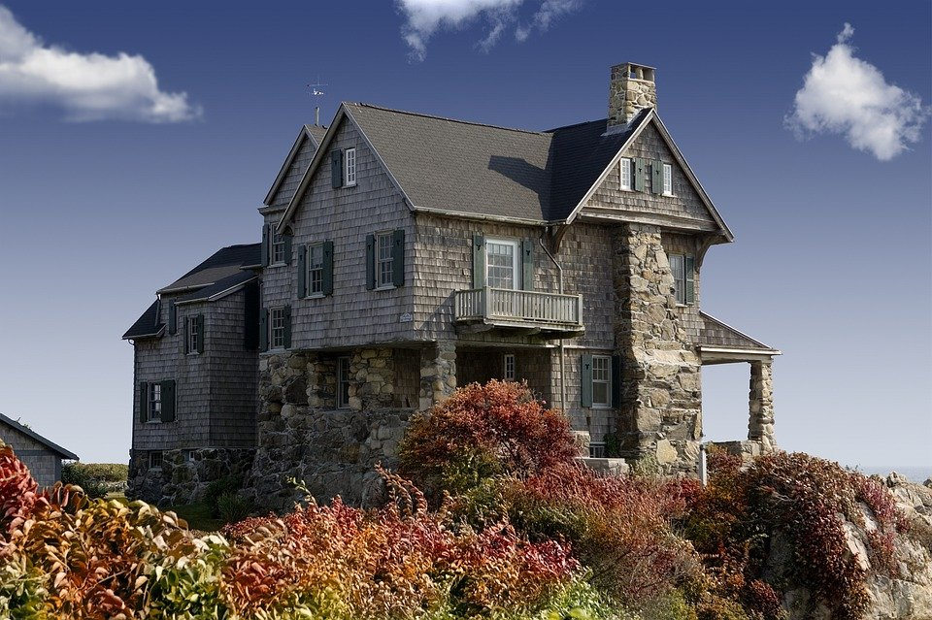
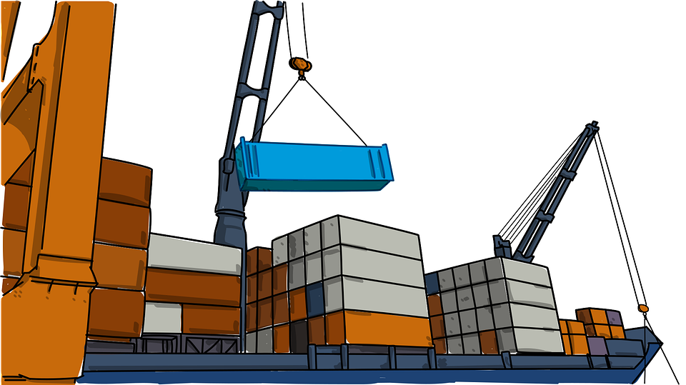
Words where ‘ex’ means ‘out’
exit
exhale
expire
external
export
explode

Slide 20
Word Sort
Can you sort these words according to the
number of syllables?
available
accommodate
suggest
determined
competition
muscle
identity
existence
rhyme
prejudice
1 syllable
2 syllables
3 syllables
4 syllables
Notes:
Click on each word for it to move into the correct circle.

Slide 21
Syllable Maps
How many syllables do these words have?
4
accommodate
ac|com|mo|date
4
available
a|vail|a|ble
Notes:
Click on the slide to show the number of syllables and how it is written.

Slide 22
Challenge Words
To be able to segment words into the correct syllables and phonemes
To spell words with irregular spelling patterns
Read the word. Write each word out, drawing long lines for the syllable breaks. Finally, write the word out again.
Word | Syllable Breaks | Word
accommodate | ac|com|mo|date | accommodate
available
competition
determined
suggest
existence
identity
muscle
prejudice
rhyme

Slide 23
Challenge Words
Answers
Word | Syllable Breaks | Word
accommodate | ac|com|mo|date | accommodate
available | a|vail|a|ble | available
competition | com|pe|ti|tion | competition
determined | de|ter|mined | determined
suggest | sug|gest | suggest
existence | ex|ist|ence | existence
identity | i|den|ti|ty | identity
muscle | mus|cle | muscle
prejudice | prej|u|dice | prejudice
rhyme | rhyme | rhyme

Slide 24
Phoneme Maps
Use a dot for each single letter sound and a line when two letters make one sound.
rhyme
muscle
suggest

Slide 25
Irregular Spelling Pattern
prejudice
Why might ‘prejudice’ be a difficult word to decode?
The ‘-ice’ suffix is pronounced ‘iss’.
Can you think of any other words that share this ending?
notice, office, service, practice, justice

Slide 26
Irregular Spelling Pattern
When a word ends with the /l/ sound, sometimes it is spelled ‘el’ and other times ’le’.
Can you decide which word has which ending?
le
el
little or littel
muscle
tunnel
bicycle or bicycel
little
example or exampel
travel
bicycle
bottle or bottel
camel
example
tunnle or tunnel
bottle
vegetable or vegetabel
travle or travel
vegetable
el used after the letters m, n, r, s, v and w.
camle or camel
dwindle
dwindle or dwindel
Notes:
Read the following words to the children and ask them to decide which box (le or el) it needs to be placed in. Ask them to look at the rule in order to make their decision.
The most common way is to spell it with ‘le’ and less common is ‘el’. )The –el spelling is used after m, n, r, s, v, w and more often than not after s.)

Slide 27
Cloze Sentences
Can you identify the missing words in
these sentences?
accommodate
available
competition
determined
suggest
existence
identity
muscle
prejudice
rhyme
The gluteus maximus is the largest in the human body.
Some people believe in the of extra-terrestrial beings.
May I we take a democratic vote on the issue?
Believe and deceive are words that .
The art was won by a sensational landscape painting.
Notes:
Complete one sentence at a time. This slide provides the children with their words so that they are able to choose the appropriate missing word for each sentence.

Slide 28
Cloze Sentences
Can you identify the missing words in
these sentences?
Local police cells are able to up to fifteen ‘guests’, with neighbouring stations’ lockups if necessary.
Whether a suspect is remanded in custody or not is by the custody sergeant, who will ask them for proof of their and where they reside.
Suspects are also entitled to legal representation, where a solicitor would be present in order to ensure that no occurs and that the law is followed appropriately.
Notes:
This slide removes the words so that the children are able to practise spelling them.
They could use whiteboards and 1-2-3-Show Me for instant assessment and the ability to address incorrect spelling of words.

Slide 29
Cloze Sentences
Answers
accommodate
available
competition
determined
suggest
existence
identity
muscle
prejudice
rhyme
muscle
The gluteus maximus is the largest in the human body.
existence
Some people believe in the of extra-terrestrial beings.
suggest
May I we take a democratic vote on the issue?
rhyme
Believe and deceive are words that .
competition
The art was won by a sensational landscape painting.

Slide 30
Cloze Sentences
Answers
accommodate
Local police cells are able to up to fifteen ‘guests’, with neighbouring stations’ lockups if necessary.
available
Whether a suspect is remanded in custody or not is by the custody sergeant, who will ask them for proof of their and where they reside.
determined
identity
Suspects are also entitled to legal representation, where a solicitor would be present in order to ensure that no occurs and that the law is followed appropriately.
prejudice

Slide 31
Challenge Words
Find the dictionary definition for the words below.
Then write your own sentence for each.
Word | Dictionary Definition | In a Sentence
accommodate
available
competition
determined
suggest
existence
identity
muscle
prejudice
rhyme

Slide 32
Challenge Words
Possible Answers
Word | Dictionary Definition | In a Sentence
accommodate | Providing somewhere to stay or something needed or desired. | The hotel can accommodate up to 500 guests.
available | Able to be used or possible to get. | We'll send you a copy as soon as it becomes available.
competition | An event in which people compete with each other to find out who is the best at something. | Hundreds of schools entered the competition.
determined | Making a decision and not changing it. | I'm determined to succeed.
suggest | Put forward an idea or plan. | I'd like to suggest a different explanation for the accident.
existence | The state or fact of being real or living or of being present. | The mere existence of these strange creatures fascinated him.
identity | Who or what somebody/something is. | Do you have any proof of identity?
muscle | Tissue within the body which contracts and relaxes. | This exercise will work the muscles of the lower back.
prejudice | A biased opinion not based on reason. | Their decision was based on ignorance and prejudice.
rhyme | Words with the same or similar end sounds. | The children made up a rhyme about a frog and a dog sitting on a log.

Slide 33
Definition
In a Sentence
determined
Synonyms
Antonyms

Slide 34
Definition
In a Sentence
After robbing the bank, the thief was determined to evade capture from the police.
Making a decision and not changing it.
determined
Synonyms
Antonyms
decisive, strong-willed,
serious, firm, resolute,
driven, stubborn
weak, unmotivated,
complacent, feeble, unsure, indecisive

Slide 35
Morphology Matrix
How many new words can you create by adding
a prefix and/or suffix(es)?
Prefix
Base Word
Suffix
s
d
ing
ion
un
(not)
accommodate
(to provide enough space for somebody/something)
Remember what happens to the final ‘e’ when adding certain suffixes.
Notes:
Children to create new words using their spelling word accommodate. Children could be asked to put these new word into a sentence to demonstrate their understanding.

Slide 36
Morphology Matrix
How many new words can you create by adding
a prefix and/or suffix(es)?
Prefix
Base Word
Suffix
s
d
ing
ion
un
(not)
accommodate
(to provide enough space for somebody/something)
Possible answers: accommodates, accommodated, accommodating, accommodation, unaccommodated, unaccommodating

Slide 37
Example: Grammar & Punctuation Lesson

Slide 38
Identifying passive and active voice
Stage 6 Sentence S1
National Curriculum Teaching Point:
Use the passive to affect the presentation of information in a sentence
Key vocabulary: active, passive, verb
Notes:
The grammatical differences between plural and possessive -s

Slide 39
Active and Passive voice
Albert opened the presents.
The presents were opened by Albert.
What is the difference between these two sentences?

Slide 40
Active and Passive voice
Albert opened the presents.
The presents were opened by Albert.
The subject in the sentence (Albert) performs the action stated by the verb.
The subject (Albert) is not performing the verb. This is an example of passive voice.

Slide 41
Decide which sentences are written in the passive voice.
Monty kicked the ball.
PASSIVE
The birthday card was made by Yasmin.
ACTIVE
The model was built by James.

Slide 42
Passive voice can be identified when there is a ‘by someone’ in the sentence.
The model was built by James.
In this sentence ‘was built’ is the passive verb.

Slide 43
Identify the passive verb in the sentences below.
The letter by the postman.
was delivered
check
passive verb
was performed
The play by the actors.
check
passive verb
The tomb by Howard Carter.
was discovered
passive verb
check

Slide 44
Identify the passive verb in the text below.
The lecture was delivered by the teacher. The children were not listening because there was cake. The delicious, chocolate cake was devoured by the children.

Slide 45
Identify the passive verbs in the text below.
The lecture was delivered by the teacher. The children were not listening because there was cake. The delicious, chocolate cake was devoured by the children.

Slide 46
Change the sentence from active to passive.
Dolphins ate the fish.
Dad washed the car.
Steve climbed the mountain.
The fish were eaten by the dolphins.
The car was washed by dad.
The mountain was climbed by Steve.

Slide 47
Rearrange the sentence fragments to create an active sentence.
.
ladder
Noah
the
climbed
Noah climbed the ladder.

Slide 48
Rearrange the sentence fragments to create a passive sentence.
Noah
climbed
.
ladder
The
was
by
The ladder was climbed by Noah.

Slide 49
Rearrange the sentence fragments to create an active and passive sentence.
by
The
children
eaten
ate
The
was
.
the
teachers
the
sweets
Ice-cream

Slide 50
Maybe you said:
The children ate the sweets.
The ice-cream was eaten by the teachers.
How do we know
that this one
can’t be right?
The children ate the ice-cream.
The sweets was eaten by the teachers.
Notes:
sweets

Slide 51
Your turn! Write your own sentences using the passive voice. Use the verbs below.
fly
listen
ate

Slide 52
The Natural Curriculum – Years 4 – 6 for Grammar https://www.naturalcurriculum.co.uk/
Year 6 Grammar Session on Colons: https://www.naturalcurriculum.co.uk/year-6-grammar-lessons/colons-for-lists/flying-fish/screen-1/

