Slide 1
THE WORLD OF ANIME
everything from astro boy to my hero academia will be covered. Leaving you an anime/manga genius

Slide 2
Introduction to anime
Anime has influenced, amazed and excited the world for decades and in this slide we’ll look through the classics to the ones that kids talk about today
So lets get into it…

Slide 3
This is one of the oldest animes in the book and maybe the best ever The animatrix
if this classic never came out
The anime world would have never existed.
(this is a unique take on the hit movie ‘the matrix’)

Slide 4
As you can see it’s pretty obvious
The animatrix
The matrix

Slide 5
Meanwhile…
At the same time the animatrix was released, tezuka productions were working on their very own hit tv series…
Astro boy

Slide 6
Astro boy isn’t exactly well known but it is remembered as the series that made anime famous
It was later remade in 2009 for Netflix
Listen to the theme tune here!!!
https://www.youtube.com/watch?v=8oiPVxT7Bgg
(you’ll have to copy and paste sorry)

Slide 7
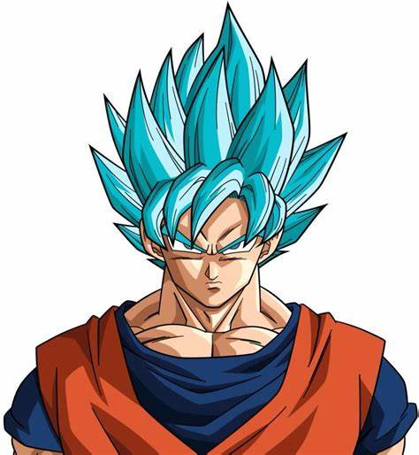
Dragon ball
Fast forward a couple years…
This has been voted the most well-known anime on the planet, and it’s definitely true.
This manga/anime follows the story of a young hero named goku and his friends vegeta and piccolo
He later meets more friend, gains power that others don’t have and finally brings justice to the man who enslaved and burnt his entire planet to the ground. Goku for the win!!!

Slide 8
2nd in the ‘well-known awards’ is the hit series Naruto!!!
This is a story of two villages on a journey.
This was made by Masashi Kishimoto the incredible manga artist.
This special character loves his ramen- zoe prime.

Slide 9
Goku fact file:
This character features in the anime dragon ball with over 240 million copies sold worldwide
wow!

Slide 10
Naruto: Fact file
This character features in the anime ‘Naruto’ and all of it’s stories
This series has sold over 235 million copies worldwide.
Double wow!

Slide 11
NEXT DRUM ROLL PLEASE
……………………………………..

Slide 12
MY HERO ACADEMIA
THIS IS MY FAVORITE ANIME!!
This story is about a world filled with superpowers . And a boy called izuku midoriya who looks up to heroes but sadly doesn’t have a power.
Until….

Slide 13
All might
The no.1 hero, izuku’s all time favorite hero reveals the secret to his power.. A strength enhancing quirk that has been passed down through generations of people. izuku is given this power. And with that he goes on a journey to become the greatest hero the world has ever seen!!!

Slide 14
Fact file: izuku midoriya
This worthy character has a power passed down from generations that smashes through the roof
Kohei horikoshi has sold over 50 million copies world wide
GO IZUKU!!!

Slide 15
THERE ARE OTHER AWESOME ANIMES KNOWN BY CHILDREN TODAY WORTH APPRECIATING. Such as….
Demon slayer, Tokyo ghoul, asterisk war, hunter x hunter, assanation classroom, haikiyuuu!!!, kuroko’s basketball, terror in resinanace, boogiebop, gokudolls, high school dxd. And soooooo many more!

Slide 16
DEMON SLAYER AND TOKYO GHOUL.

Slide 17
Asterisk war and hunter x hunter

Slide 18
Assassination classroom and haikyu!

Slide 19
Kuroko’s basketball and terror in resinance

Slide 20
Now you’re an anime genius!
I suggest watching all the tv shows shown in this slide

Slide 21
And lastly……………………..

Slide 22
Detroit… smaaaaash!
(my hero academia reference)

